Slide 1

Tamacoinchi
Enis Tola, Florian Huber, Alexander Parr

Slide 2

1. Problem

Slide 3
Problem of Tamagotchi
Problem 1
No connection between you and your friends.
Problem 2
To start over again and again is frustrating
Problem 3
Centralization of the data

Slide 4

3. Solution / How it works

Slide 5
The Solution: Tamacoinchi
Solution 1
You can connect your Tamacoinchi with friends
Solution 2
Friends Can revive your Tamacoinchi
Solution 3
First step to learn playfully the Blockchain Technology
Solution 4
Decentralization of the data with the Blockchain

Slide 6
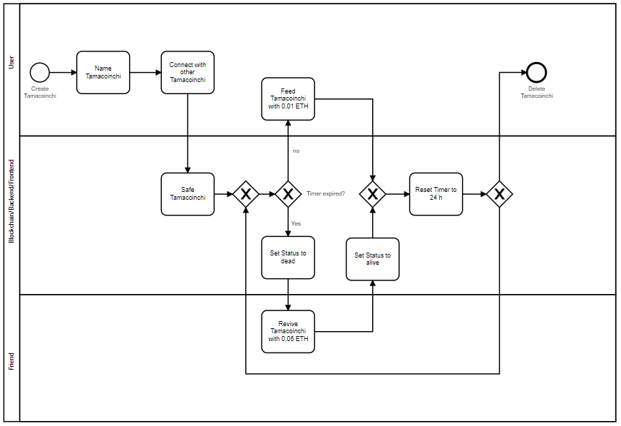
BPMN Model

Slide 7

4. MarkEt

Slide 8
Who Are Our Customers?
Kids
6-14 years
friendly content
Parental control settings
Data security
Seniors
70+ years
Large icons and an easy-to-use UI
Tamagotchi lovers
25-40 years
Recover old Tamagotchi feeling

